Slide 1
Chapter 7
Multiple Division Techniques

Slide 2
Outline
Frequency Division Multiple Access (FDMA)
Time Division Multiple Access (TDMA)
Code Division Multiple Access (CDMA)
Comparison of FDMA, TDMA, and CDMA
Walsh Codes
Near-far Problem
Types of Interferences
Analog and Digital Signals
Basic Modulation Techniques
  Amplitude Modulation (AM)
  Frequency Modulation (FM)
  Frequency Shift Keying (FSK)
  Phase Shift Keying (PSK)
  Quadrature Phase Shift Keying (QPSK)
  Quadrature Amplitude Modulation (QAM)

Slide 3
Frequency Division Multiple Access (FDMA)
Frequency
User n
…
User 2
User 1
Time
Single channel per carrier
All first generation systems use FDMA

Slide 4
Time Division Multiple Access (TDMA)
Frequency
User 1
…
User 2
User n
Time
Multiple channels per carrier
Most of second generation systems use TDMA

Slide 5
Code Division Multiple Access (CDMA)
Frequency
User 1
.
User 2
.
.
User n
Time
Code
Users share bandwidth by using code sequences that are orthogonal to each other
Some second generation systems use CDMA
Most of third generation systems use CDMA

Slide 6
Types of Channels
Control channel
  Forward (Downlink) control channel
  Reverse (Uplink) control channel
Traffic channel
  Forward traffic (traffic or information) channel
  Reverse traffic (traffic or information) channel

Slide 7
Types of Channels (Cont’d)
Reverse channel (Uplink)
Control channels
f ’
f
f₁’
f₂’
…
f_{n}’
f₁
f₂
…
f_{n}
Forward channels
(Downlink)
MS
Traffic channels
BS

Slide 8
FDMA
MS #1
f₁’
f₁
MS #2
f₂’
f₂
…
…
…
f_{n}’
f_{n}
MS #n
BS
Reverse channels
(Uplink)
Forward channels
(Downlink)

Slide 9
FDMA: Channel Structure
Guard Band W_{g}
Sub Band W_{c}
…
1
2
3
4
N
Frequency
Total Bandwidth W=NW_{c}
f₁’
f₂’
f_{n}’
f₁
f₂
f_{n}
…
…
Frequency
Reverse channels
Forward channels
Protecting bandwidth

Slide 10
TDMA
Frequency f ’
Slot
Frequency f
#1
…
#1
…
…
…
…
#1
…
#1
MS #1
t
t
#2
…
#2
…
…
…
…
#2
…
#2
MS #2
t
t
…
…
#n
…
#n
…
…
#n
…
#n
…
MS #n
t
t
Frame
Frame
Frame
Frame
BS
Reverse channels
(Uplink)
Forward channels
(Downlink)

Slide 11
TDMA: Channel Structure
f
Frame
Frame
Frame
#1
#2
…
#n
#1
#2
…
#n
#1
#2
…
#n
t
(a). Forward channel
f ’
Frame
Frame
Frame
#1
#2
…
#n
#1
#2
…
#n
#1
#2
…
#n
t
(b). Reverse channel

Slide 12
TDMA: Frame Structure (Cont’d)
Frequency f = f ’
Frame
Frame
#1
#2
…
#n
#1
#2
…
#n
#1
#2
…
#n
#1
#2
…
#n
Time
Forward channel
Reverse channel
Forward channel
Reverse channel
Channels in Simplex Mode

Slide 13
TDMA: Frame Structure (Cont’d)
Frequency
Frame
Frame
Frame
#1
#2
…
#n
#1
#2
…
#n
#1
#2
…
#n
Time
Guard time
Head
Data

Slide 14
Code Division Multiple Access (CDMA)
Frequency f ’
Frequency f
MS #1
C₁’
C₁
MS #2
C₂’
C₂
…
…
…
MS #n
C_{n}’
C_{n}
BS
Reverse channels
(Uplink)
Forward channels
(Downlink)
Note: C_{i}’ x C_{j}’ = 0, i.e., C_{i}’ and C_{j}’ are orthogonal codes, C_{i} x C_{j} = 0, i.e., C_{i} and C_{j} are orthogonal codes

Slide 15
Comparisons of FDMA, TDMA, and CDMA (Example)
Operation | FDMA | TDMA | CDMA
Allocated Bandwidth | 12.5 MHz | 12.5 MHz | 12.5 MHz
Frequency reuse | 7 | 7 | 1
Required channel BW | 0.03 MHz | 0.03 MHz | 1.25 MHz
No. of RF channels | 12.5/0.03=416 | 12.5/0.03=416 | 12.5/1.25=10
Channels/cell | 416/7=59 | 416/7=59 | 12.5/1.25=10
Control channels/cell | 2 | 2 | 2
Usable channels/cell | 57 | 57 | 8
Calls per RF channel | 1 | 4* | 40**
Voice channels/cell | 57x1=57 | 57x4=228 | 8x40=320
Sectors/cell | 3 | 3 | 3
Voice calls/sector | 57/3=19 | 228/3=76 | 320
Capacity vs FDMA | 1 | 4 | 16.8
Delay
?
? ?
* Depends on the number of slots ** Depends on the number of codes

Slide 16
Direct Sequence Spread Spectrum for CDMA
Transmitter
Receiver
Spreading
Despread
Digital signal s(t)
Digital signal s(t)
Spreading signal m(t)
Code c(t)
Code c(t)
Power
Power
Power
Frequency
Frequency
Frequency

Slide 17
Concept of Frequency Hopping Spread Spectrum
Transmitter
Receiver
Spreading
Despread
Digital signal
Spreading signal
Digital signal
Hopping Pattern
Hopping Pattern
Power
Power
Power
Frequency
Frequency
Frequency

Slide 18
An Example of Frequency Hopping Pattern
Frequency
Time

Slide 19
Walsh Codes (Orthogonal Codes)
Wal (0, t)
t
Wal (1, t)
t
Wal (2, t)
t
Wal (3, t)
t
Wal (4, t)
t
Wal (5, t)
t
Wal (6, t)
t
Wal (7, t)
t

Slide 20
Near-far Problem
MS₂
BS
MS₁
Received signal strength
Distance
Distance
0
d₂
d₁
MS₂
BS
MS₁

Slide 21
Types of Interference in CDMA
Interference baseband signals
Baseband signal
Despread signal
Spreading signal
Interference signals
Frequency
Frequency
Frequency
Interference in spread spectrum system in CDMA

Slide 22
Adjacent Channel Interference in CDMA
Channel₁
Channel₂
Power
Frequency
f₁
f₂

Slide 23

Power Control in CDMA
Controlling transmitted power affects the CIR
P_{t} = Transmitted power
P_{r} = Received power in free space
d = Distance between receiver and transmitter
f = Frequency of transmission
c = Speed of light
α = Attenuation constant (2 to 4)

Slide 24
Modulation
Why need modulation?
  Small antenna size
Antenna size is inversely proportional to frequency
e.g., 3 kHz → 50 km antenna
3 GHz → 5 cm antenna
  Limits noise and interference,
e.g., FM (Frequency Modulation)
  Multiplexing techniques,
e.g., FDM, TDM, CDMA

Slide 25
Analog and Digital Signals
Analog Signal (Continuous signal)
Amplitude
S(t)
Time
0
Digital Signal (Discrete signal)
Amplitude
1
0
1 1
0
1
+
0
Time
_
Bit

Slide 26
Hearing, Speech, and Voice-band Channels
Human hearing
Human speech
Voice-grade Telephone channel
..
Frequency (Hz)
100
10,000
Pass band
Guard band
Guard band
Frequency cutoff point
Frequency (Hz)
0
200
3,500
4,000

Slide 27
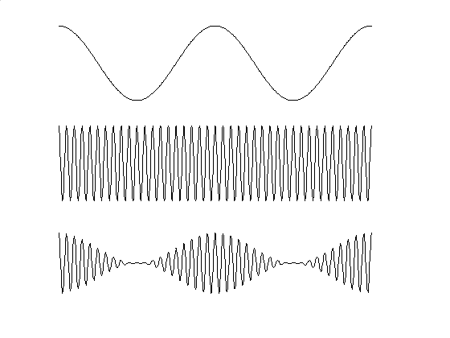
Amplitude Modulation (AM)
Message signal
x(t)
Time
Carrier signal
Time
AM signal
s(t)
Time
Amplitude of carrier signal is varied as the message signal to be transmitted.
Frequency of carrier signal is kept constant.

Slide 28
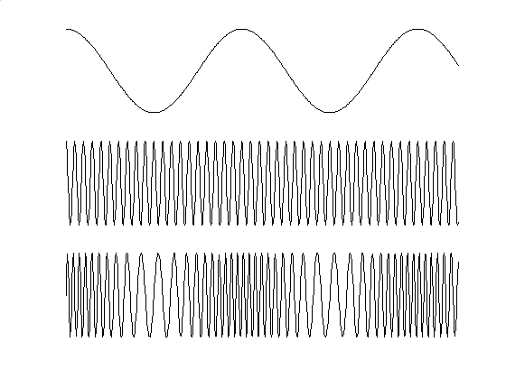
Frequency Modulation (FM)
Message signal
x(t)
Time
Carrier signal
Time
FM signal
s(t)
Time
FM integrates message signal with carrier signal by varying the instantaneous frequency. Amplitude of carrier signal is kept constant.

Slide 29
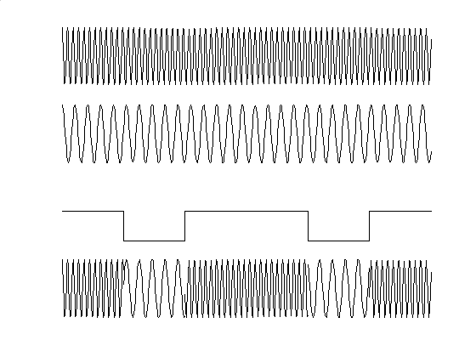
Frequency Shift Keying (FSK)
1/0 represented by two different frequencies slightly offset from carrier frequency
Carrier signal 1
for message signal ‘1’
Time
Carrier signal 2
for message signal ‘0’
Time
1 0 1 1 0 1
Message signal
x(t)
Time
FSK signal
s(t)
Time

Slide 30
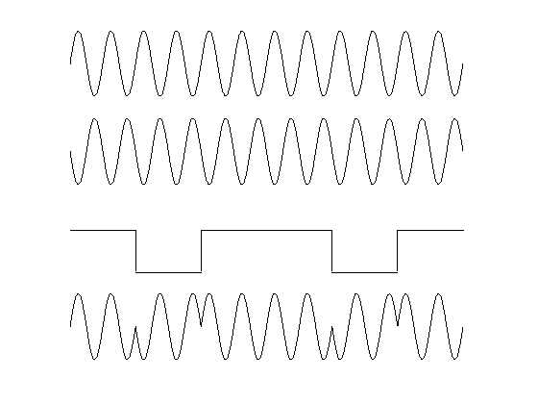


Phase Shift Keying (PSK)
Use alternative sine wave phase to encode bits
Carrier signal
Time
Carrier signal
Time
1 0 1 1 0 1
Message signal
x(t)
Time
PSK signal
s(t)
Time

Slide 31
QPSK Signal Constellation
Q
Q
0,1
1
0
1,1
0,0
I
I
1,0
(a) BPSK
(b) QPSK

Slide 32
All Possible State Transitions in π/4 QPSK

Slide 33
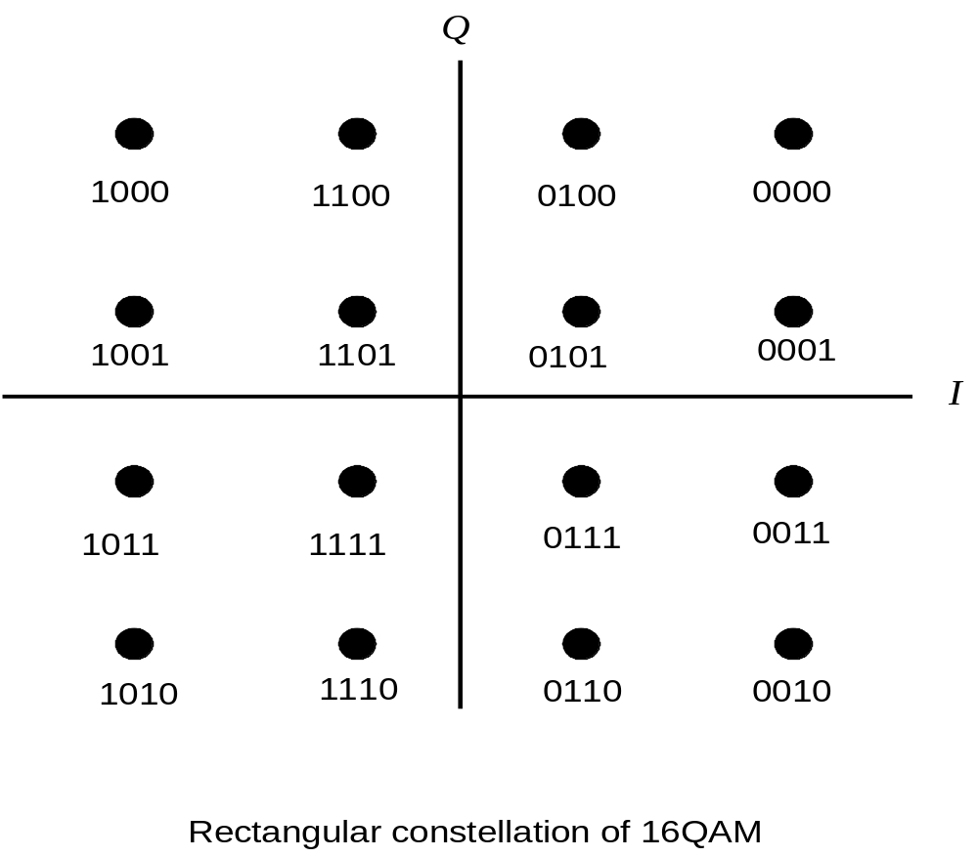
Quadrature Amplitude Modulation (QAM)
Combination of AM and PSK
Two carriers out of phase by 90 deg are amplitude modulated

